Slide 1


Welcome to Python for Geosciences
Dr. Shuang Zhang
shuang-zhang@tamu.edu

Slide 2
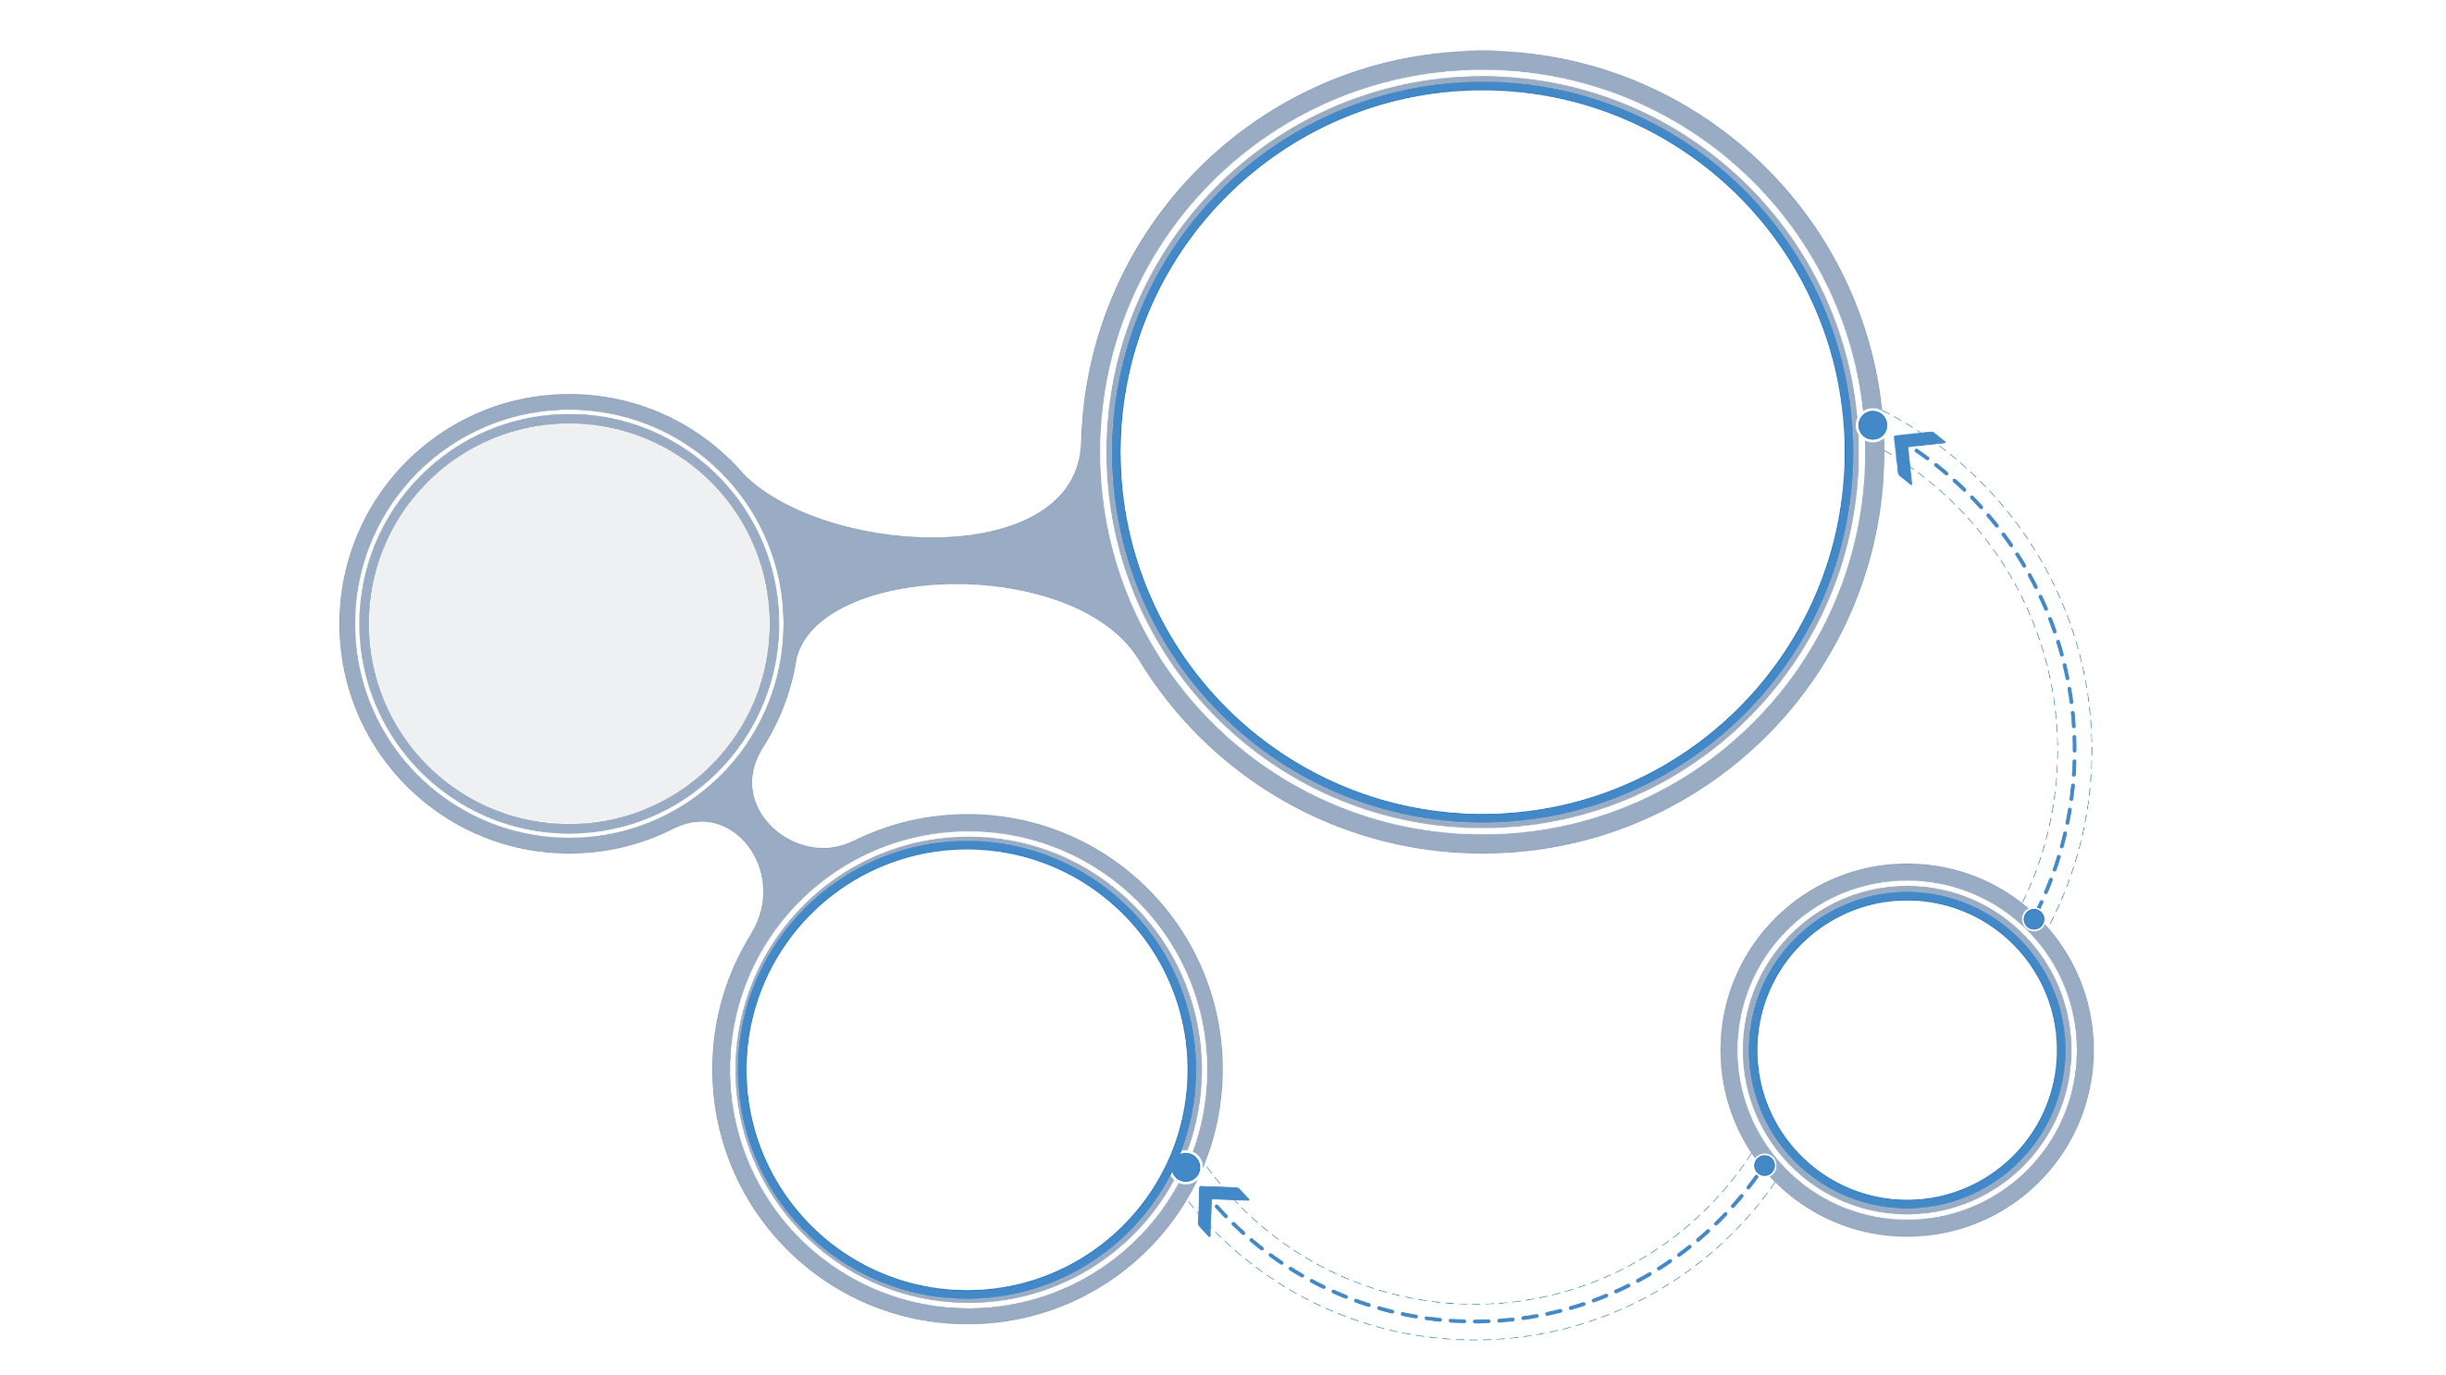

About me
研究方向
Global carbon cycle
Research
focus
Data science
Numerical model
Climate change
My website: https://www.shuang-zhang.space/

Slide 3
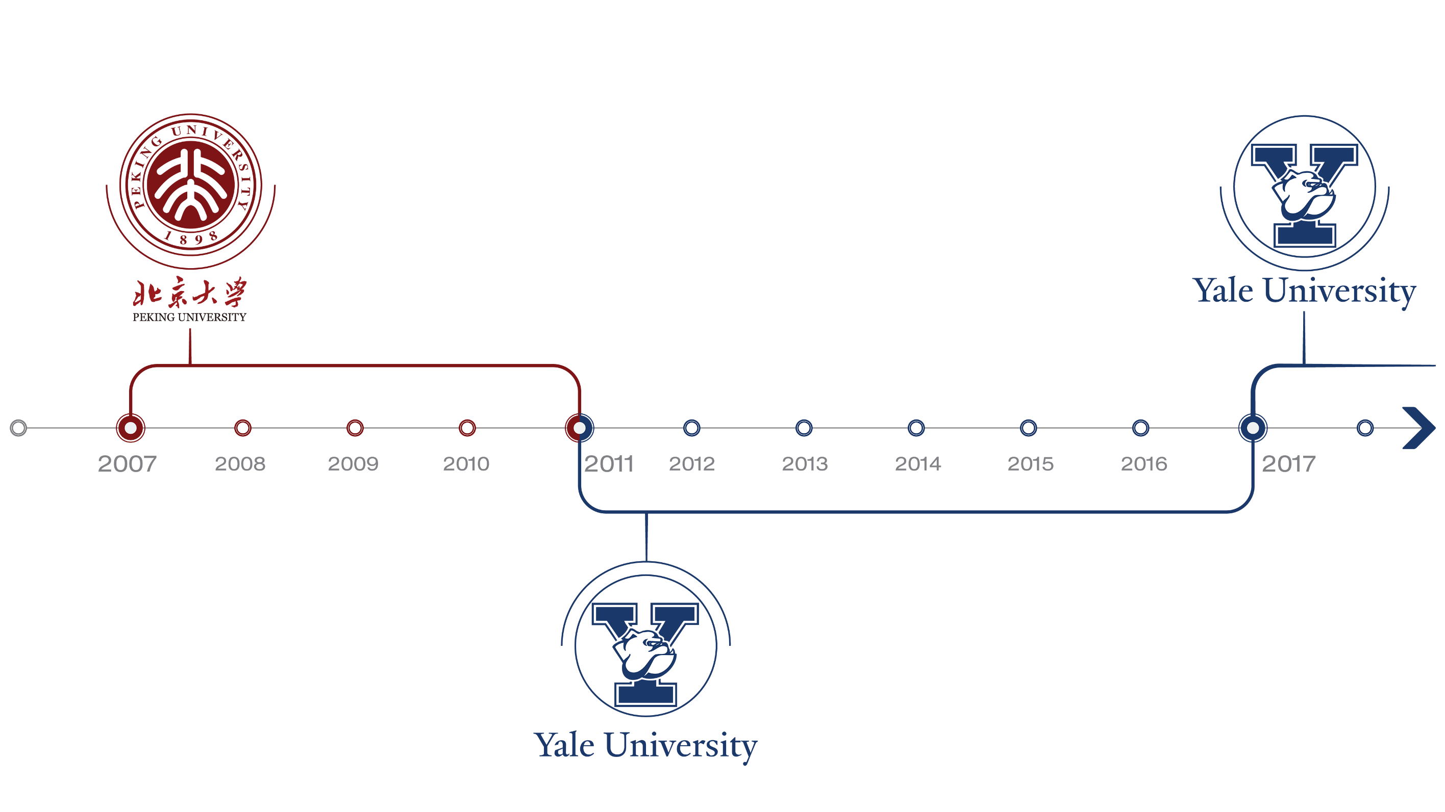
About me
Undergraduate (Geology)
Peking University（2007–2011）
Postdoc
Yale University（2017–）
Ph.D. (Geochemistry)
Yale University（2011–2017)

Slide 4

About me
After working as a postdoc at Carnegie Institution for Science in DC from 2019 to 2020, I joined Texas A&M University on Jan 01, 2021.

Slide 5

About you
Who are you?
Where are you from?
What’s your major?
What do you expect from this class?

Slide 6
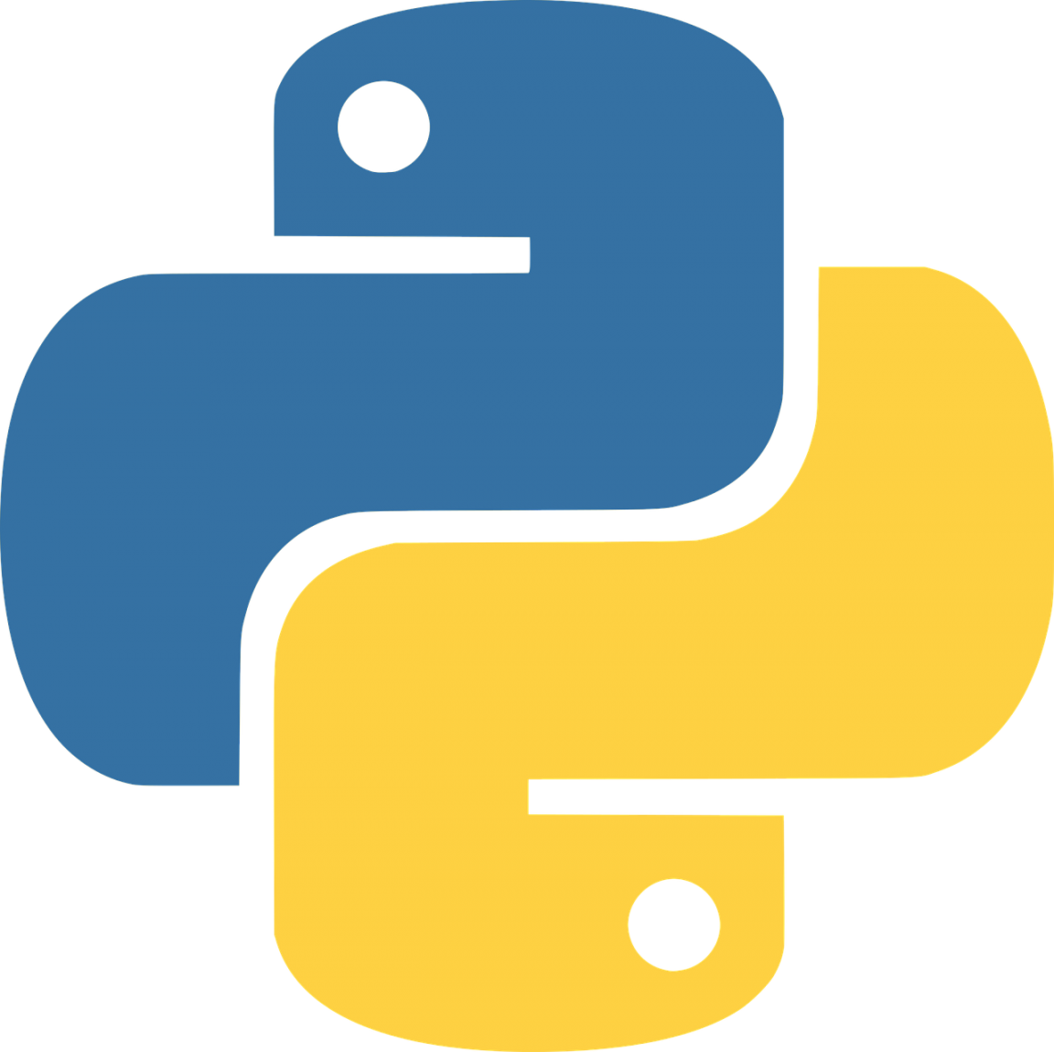


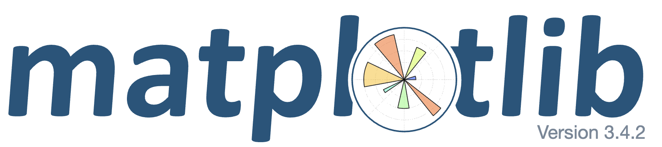
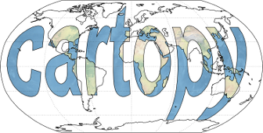



What is covered in the course?
Data manipulation
Basic types
Array and DataFrame
Data visualization
Basic plots
Geospatial plots
Geospatial analysis
Vector files
Raster files
Notes:
You might become the expert or guru on Python, but you will learn to love python, love coding, especially using coding to solve your program. I will put addition references for advanced Python stuff.

Slide 7

How do we write the code?
Notes:
You might become the expert or guru on Python, but you will learn to love python, love coding, especially using coding to solve your program. I will put addition references for advanced Python stuff.

Slide 8
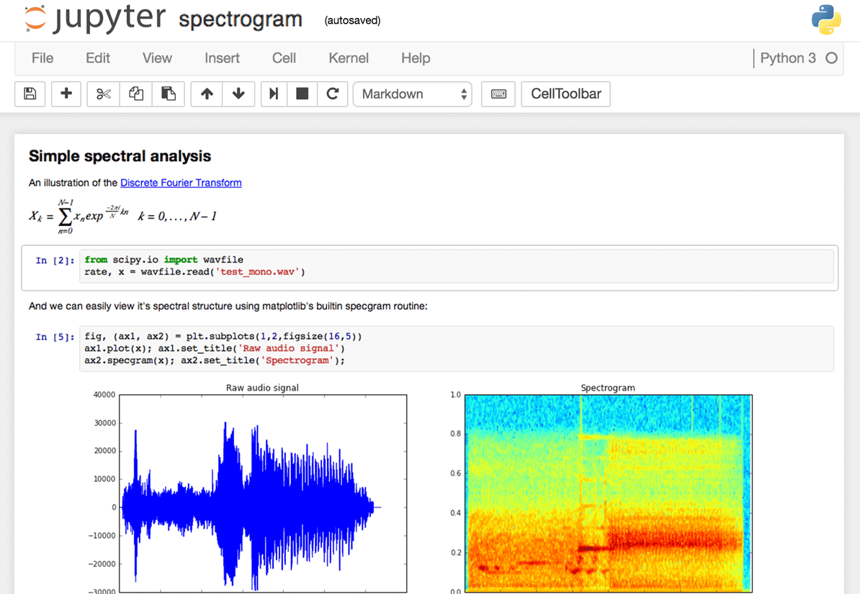
How do we write the code?
Notes:
Add my own!!!

Slide 9
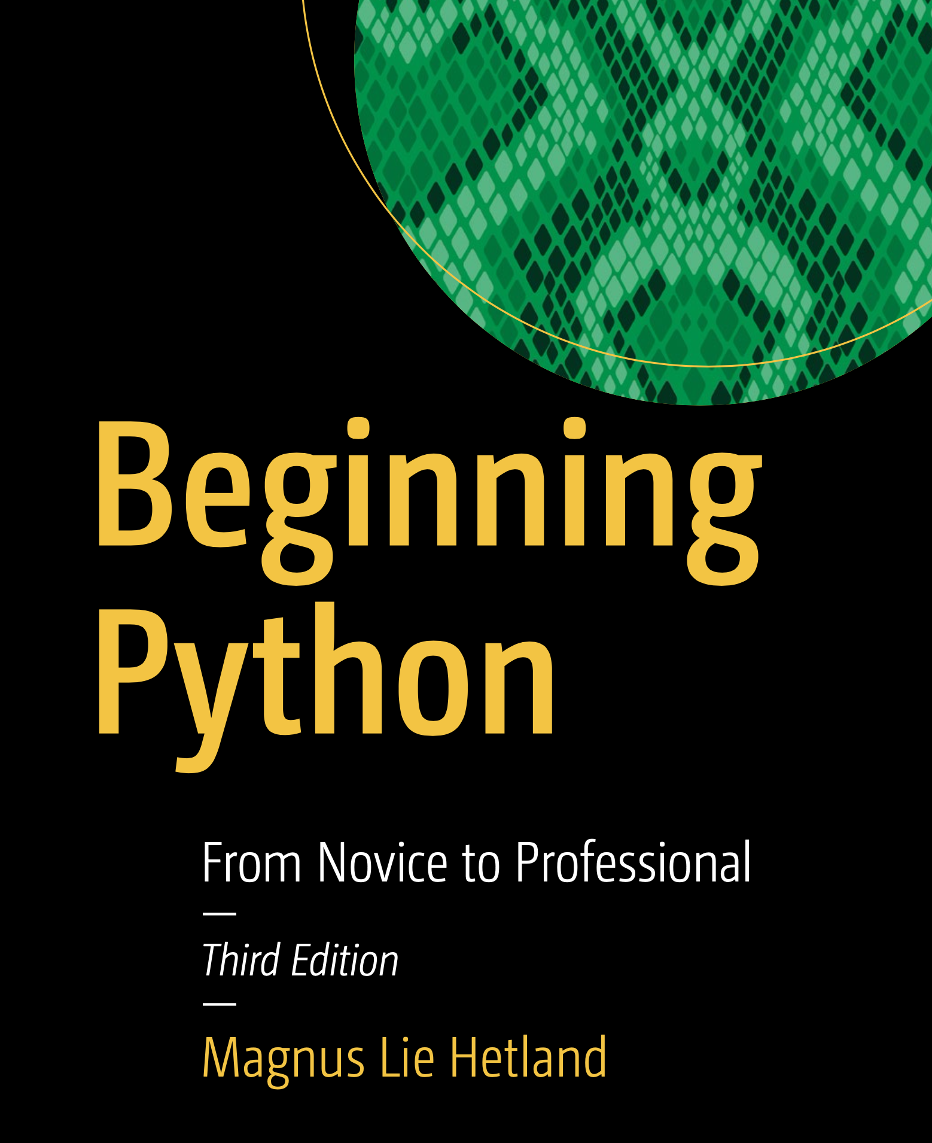
Textbook 1
Beginning Python (not required)
It's available electronically for free through the TAMU library.
Notes:
You might become the expert or guru on Python, but you will learn to love python, love coding, especially using coding to solve your program.

Slide 10
Beginning Python
Chapters related to this class:
1. Instant Hacking: The Basics
2. Lists and Tuples
3. Working with Strings
4. Dictionaries: When Indices Won’t Do
5. Conditionals, Loops, and Some Other Statements
Notes:
You might become the expert or guru on Python, but you will learn to love python, love coding, especially using coding to solve your program.

Slide 11
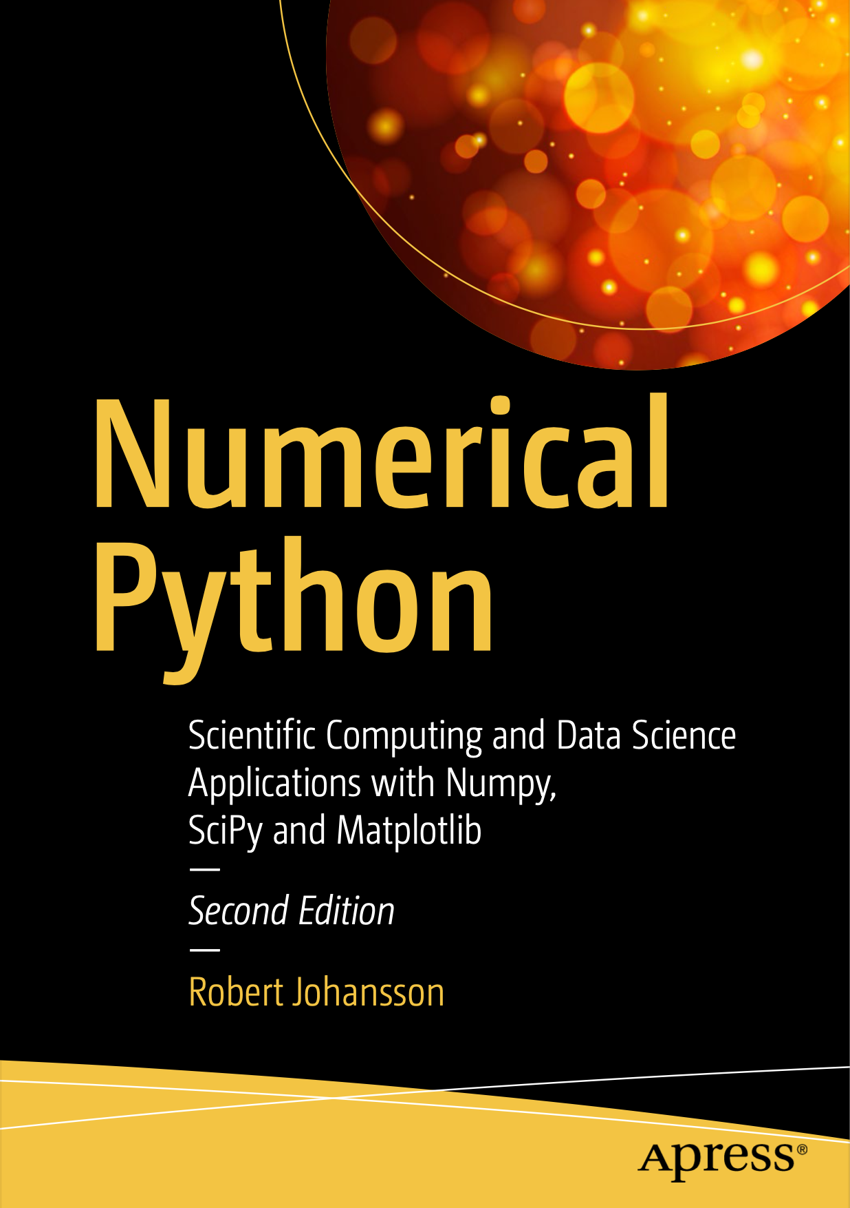
Textbook 2
Numerical Python (not required)
It's available electronically for free through the TAMU library.
Notes:
You might become the expert or guru on Python, but you will learn to love python, love coding, especially using coding to solve your program.

Slide 12
Beginning Python
Chapters related to this class:
2. Vectors, Matrices, and Multidimensional Arrays
4. Plotting and Visualization
12. Data Processing and Analysis
Notes:
You might become the expert or guru on Python, but you will learn to love python, love coding, especially using coding to solve your program.

Slide 13
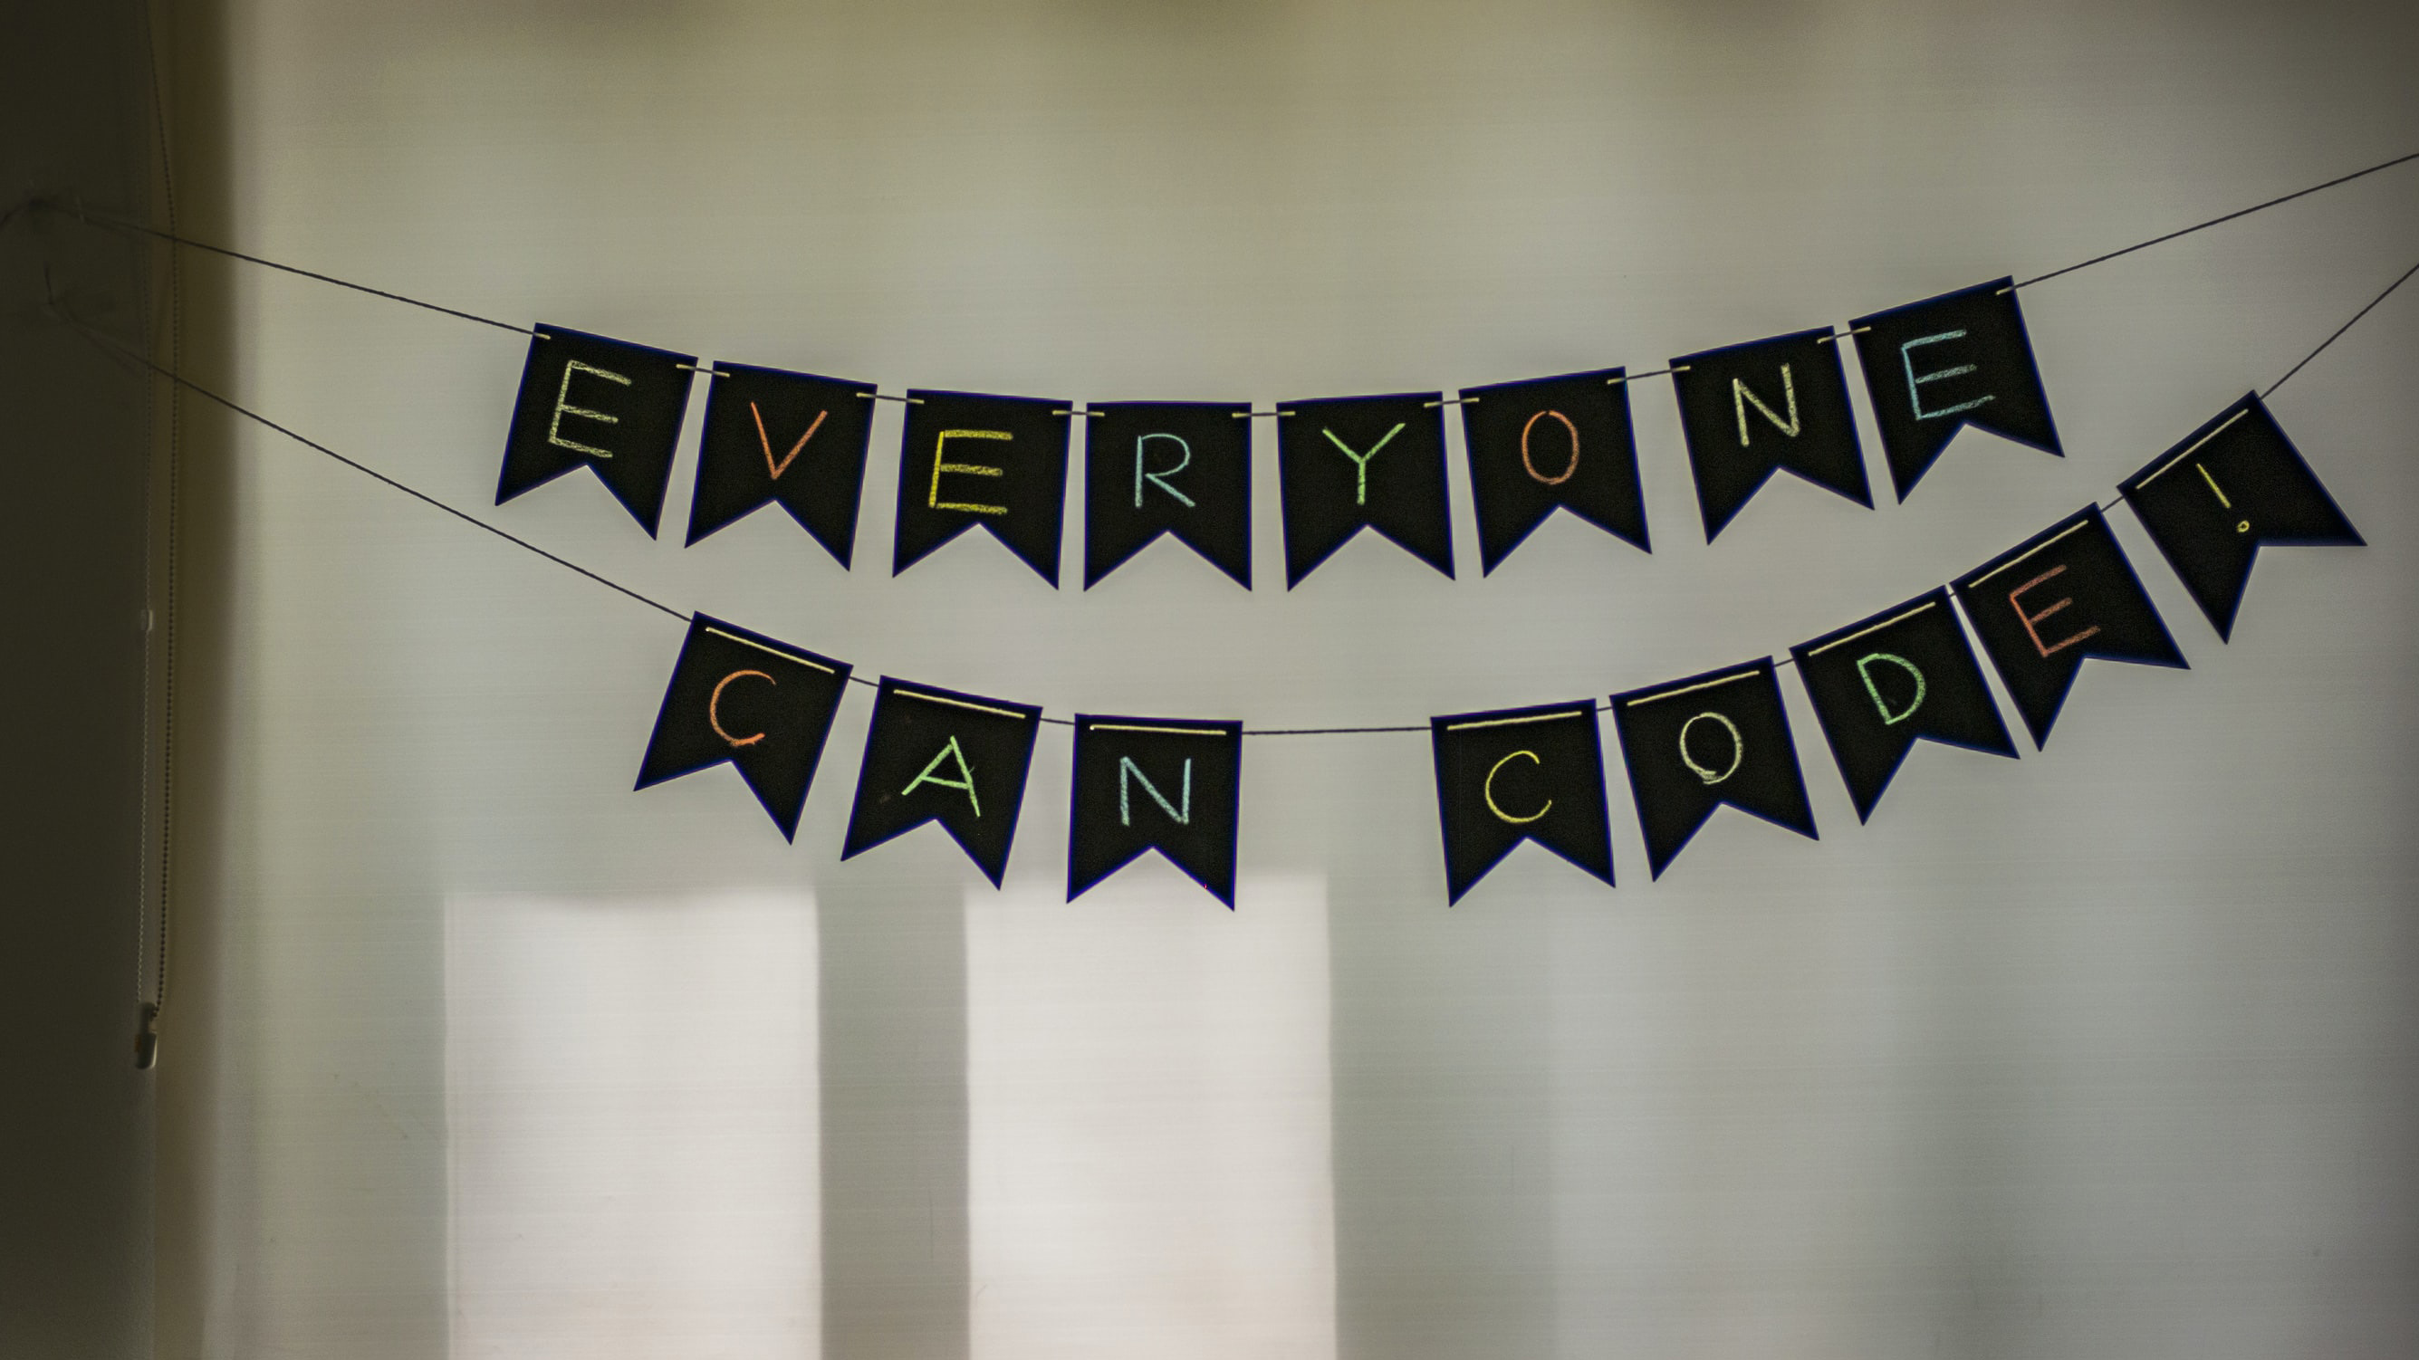
My expectations

Slide 14

How to contact me?
Office Hour: MW (11:00am-12:00am)
Location: Eller O&M 611
Or just email: shuang-zhang@tamu.edu

Slide 16
Beginning Python
Chapters in this book:
1. Introduction to Computing with Python; 2. Vectors, Matrices, and Multidimensional Arrays; 3. Symbolic Computing; 4. Plotting and Visualization; 5. Equation Solving; 6. Optimization; 7. Interpolation; 8. Integration; 9. Ordinary Differential Equations; 10. Sparse Matrices and Graphs; 11. Partial Differential Equations; 12. Data Processing and Analysis; 13. Statistics; 14. Statistical Modeling; 15. Bayesian Statistics; 16. Signal Processing; 17. Data Input and Output; 18. Code Optimization
Notes:
You might become the expert or guru on Python, but you will learn to love python, love coding, especially using coding to solve your program.

Slide 17

Thank you!

